Slide 1
Welcome Scholars!

Slide 2
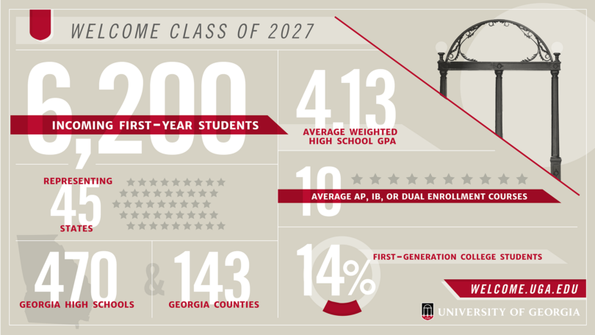
It’s a Different World!
Undergraduate Enrollment: ~31,000
Freshmen Class Size: 6,200+
Percentage Pursuing Franklin majors: 34%
Percentage Who Study Abroad: 25%
The University of Georgia has…
17 Separate Schools and Colleges
143 Major Options
Over 460 Buildings
For more statistics, see: https://oir.uga.edu/factbook/

Slide 3
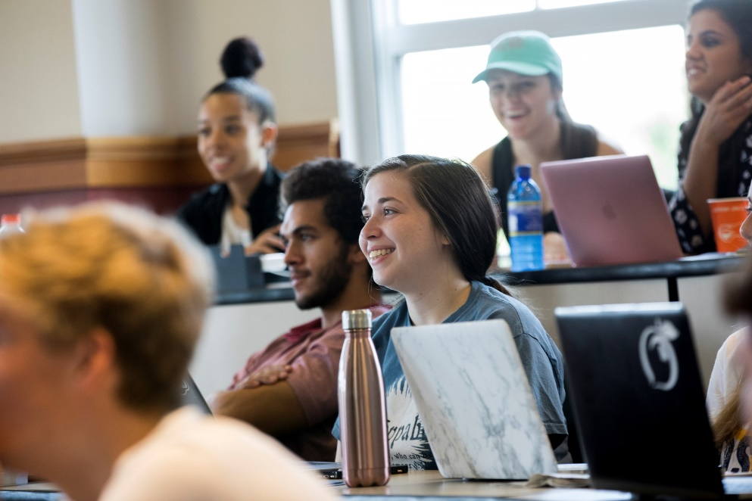
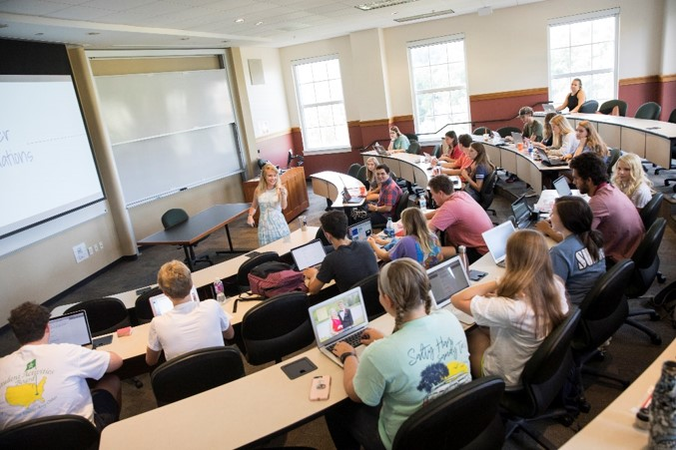
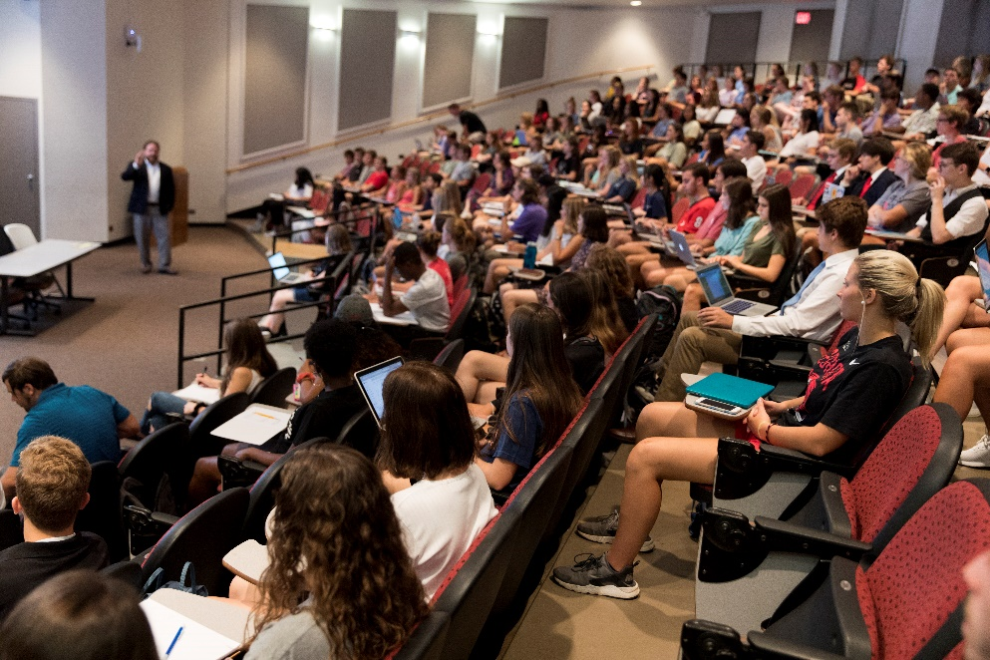
Franklin College of Arts & Sciences
“The heart of UGA’s liberal arts learning environment, the Franklin College of Arts and Sciences provides instruction in every classical discipline and all branches of empirical inquiry. Critical thinking skills, from languages and literature to biological sciences, build the foundation for every profession as they empower students to be informed, engaged citizens.”
30 Separate Departments
80+ Degree Programs
50% of Credit Hours @UGA Housed in Franklin
Instruction in 23 Different Foreign Languages
26 Study Abroad Programs on Five Continents
For recent accomplishments, see: https://www.franklin.uga.edu/accomplishments

Slide 4
Liberal Arts & Sciences Education
Types of undergraduate degrees:
AB: Bachelor of Arts – Humanities and Social Sciences
BS: Bachelor of Science – Biological, Physical, and Computational Sciences
BFA: Bachelor of Fine Arts – Studio Art, Art Education, and Dance
BMUS: Bachelor of Music – Five types of Music degrees
BSCHEM: Specialized degree in research Chemistry
All BS and AB degree-seeking students must take classes in a variety of areas to receive a true liberal arts and sciences education:
https://osas.franklin.uga.edu/franklin-college-degree-requirements

Slide 5
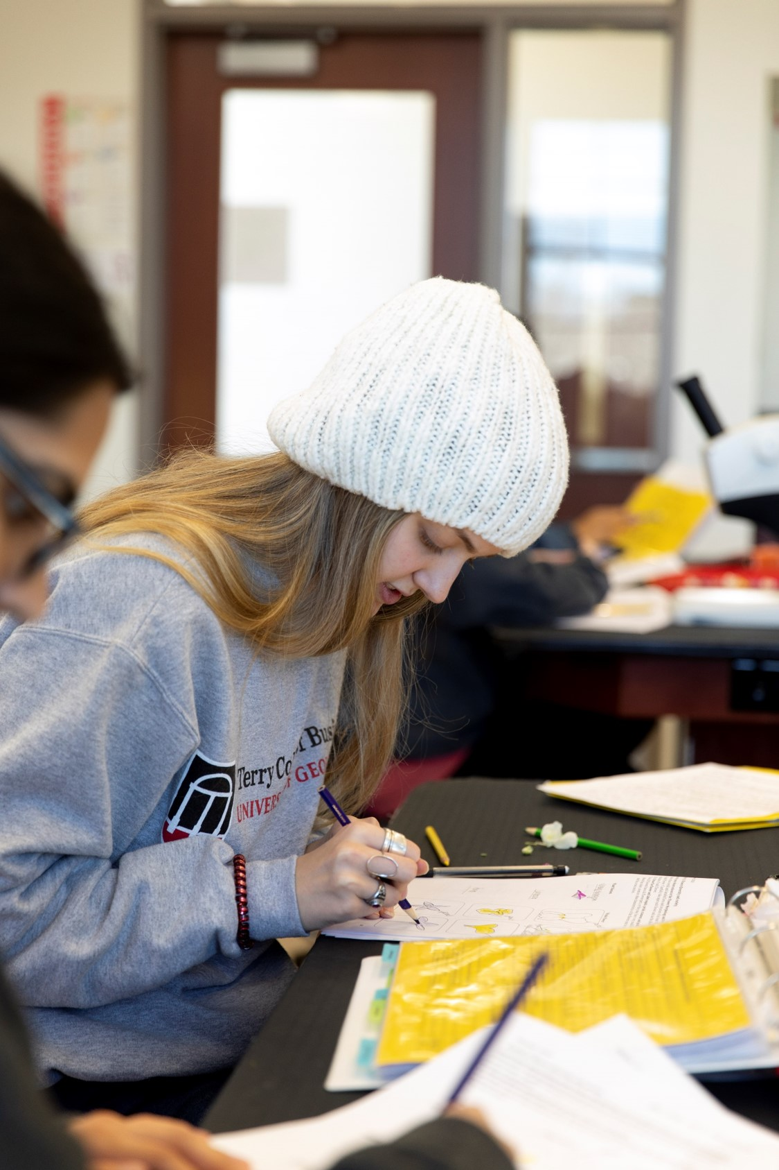
Biological Sciences
Spanning the broad field of natural sciences concerned with the study of life and living organisms. All majors are housed within the Division of Biological Sciences (except Psychology). The department of Entomology (College of Agriculture and Environmental Sciences) and the Odum School of Ecology also contribute faculty and graduate students towards BIOL course instruction.
PROGRAMS:
Biochemistry and Molecular Biology - B.S.
Biology - B.S.
Cellular Biology - B.S.
Genetics - B.S.
Microbiology (Also Offered at Griffin) - B.S.
Plant Biology - B.S.
Psychology - B.S.

Slide 6
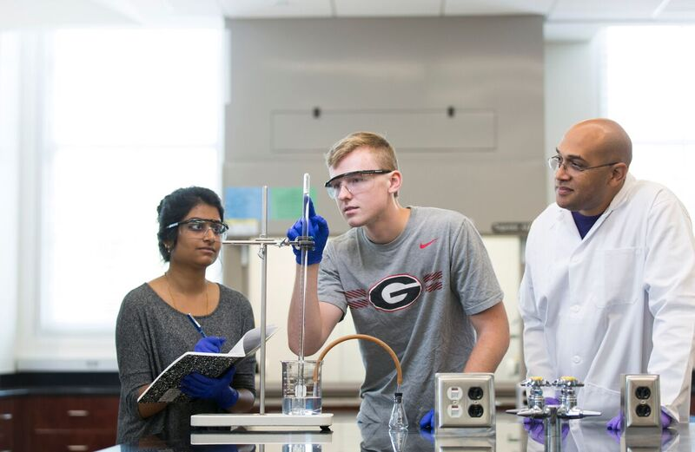
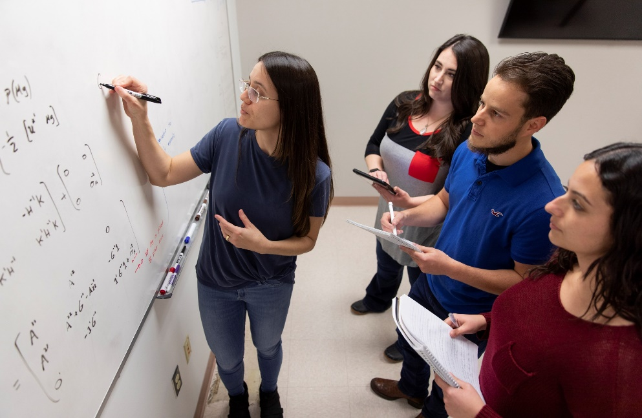
Physical & Computational Sciences
Providing a framework for the comprehensive study of the physical world and the chemistry of nature to academic disciplines primarily concerned with numerical methods, the Division of the Physical & Mathematical Sciences comprises six departments offering eleven majors.
PROGRAMS:
Astrophysics - B.S.
Atmospheric Sciences - B.S.
Chemistry - B.S.
Cognitive Science - A.B.
Computer Science - B.S.
Data Science - B.S.
Geography - B.S.
Geology - B.S.
Mathematics - B.S.
Ocean Science - B.S.
Physics - B.S.
Statistics - B.S.

Slide 7
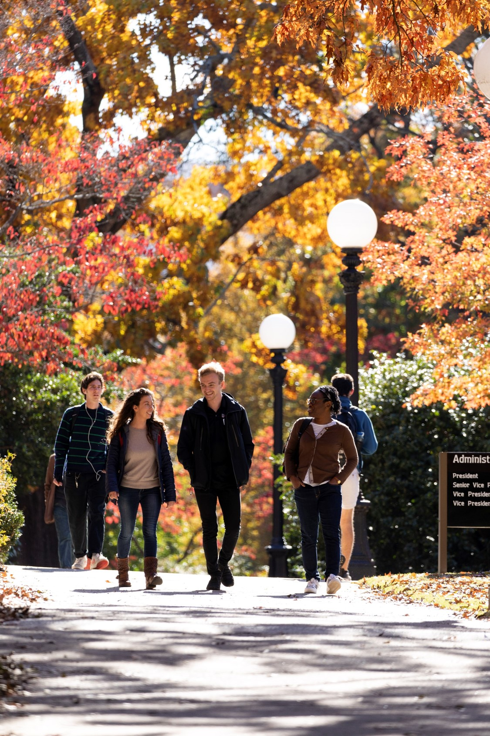
Humanities
Forming the bedrock of human culture from modern languages and literature to philosophy and religion, the Division of the Humanities comprises eight departments, and a host of concentrations and majors with more than 2,000 students from around the world enrolled in our AB, MA and PhD programs.
PROGRAMS:
African American Studies - A.B.
Arabic - A.B.
Asian Languages and Literature - A.B.
Classics - A.B.
Cognitive Science - A.B.
Comparative Literature and Intercultural Studies - A.B.
English - A.B.
French - A.B.
German - A.B.
History - A.B.
Latin American and Caribbean Studies - A.B.
Linguistics - A.B.
Philosophy - A.B.
Religion - A.B.
Romance Languages - A.B.
Russian - A.B.
Spanish - A.B.

Slide 8
Social Sciences
Investigating society and the relationships among individuals within a society, the Division of the Social Sciences is comprised of branches of knowledge reaching from the Age of the Enlightenment into the 21st century of human activity and existence.
PROGRAMS:
African American Studies - A.B.
Anthropology - A.B.
Cognitive Science - A.B.
Communication Studies - A.B.
Criminal Justice - A.B.
Geography - A.B.
Latin American and Caribbean Studies - A.B.
Psychology - B.S.
Sociology - A.B.
Women's Studies - A.B

Slide 9
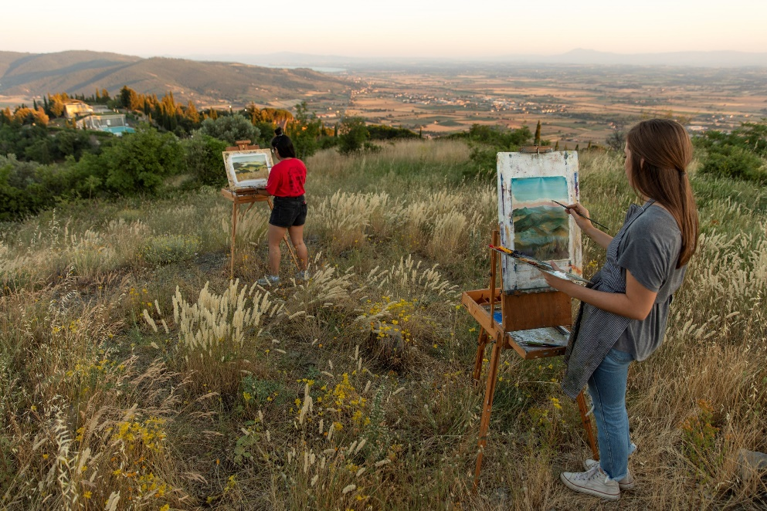
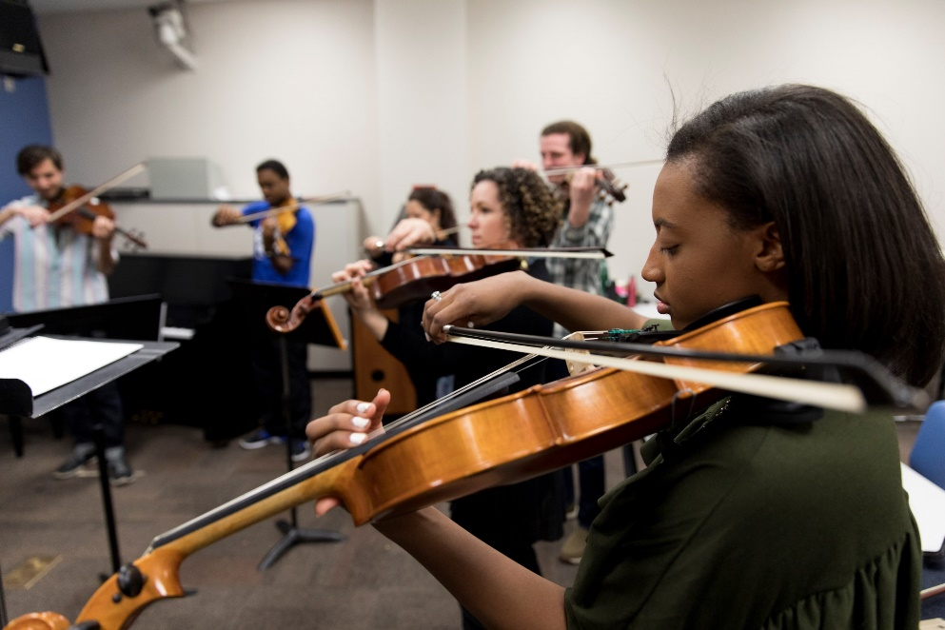
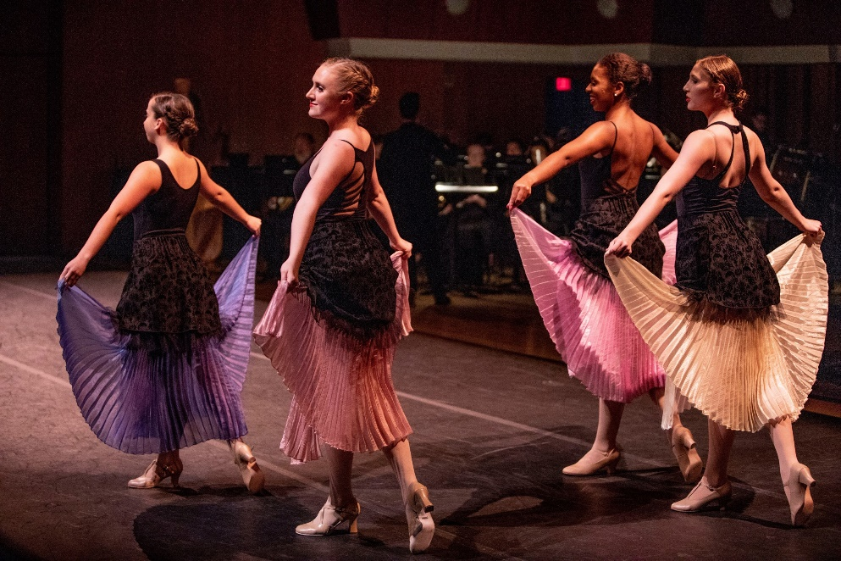
Fine Arts
Connecting our campus community with a wide variety of cultural programming, the Fine and Performing Arts boasts of a legacy of opportunity for student-artists and audiences.
PROGRAMS:
Art Degrees and Emphases (14 Area of Emphasis Options)
Dance - A.B.
Dance - B.F.A.
Film Studies - A.B.
Music Degrees (6 Degree Options, 20 Instrument Emphases)
Theatre - A.B.

Slide 10
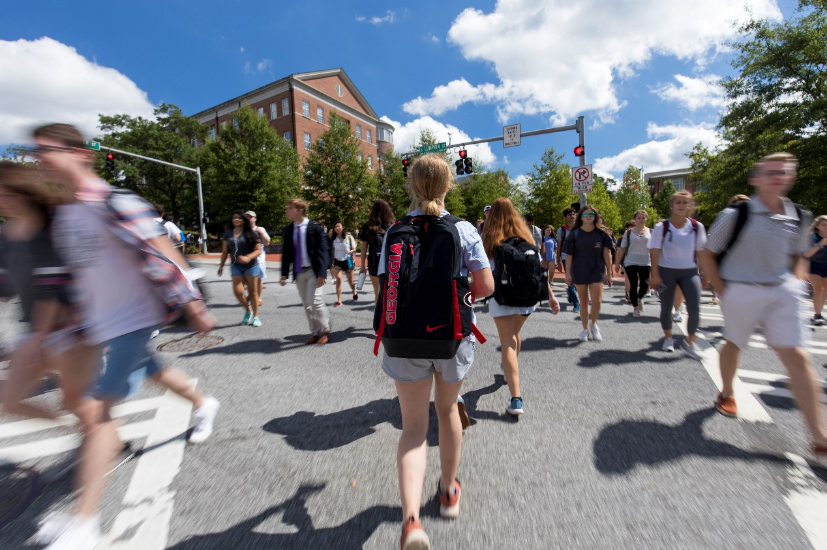
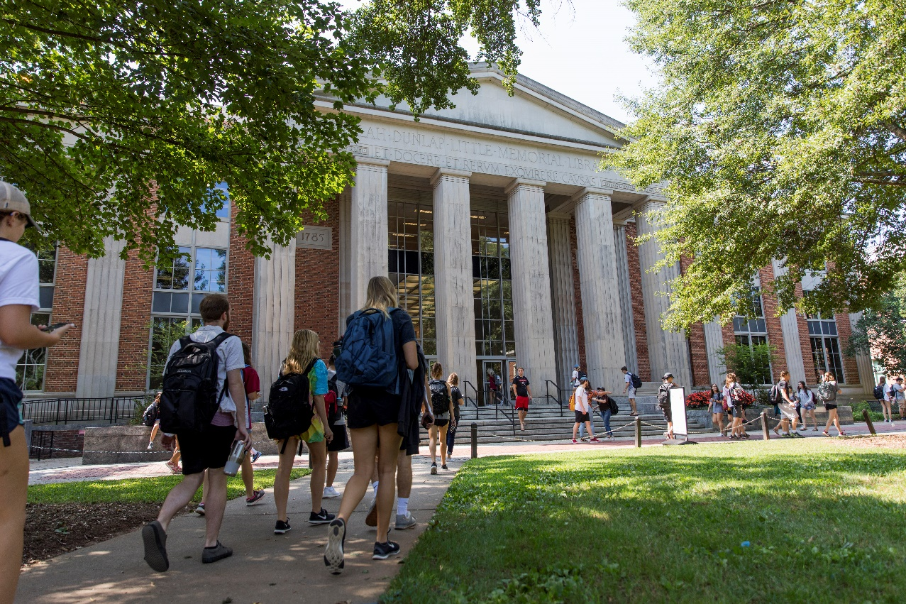
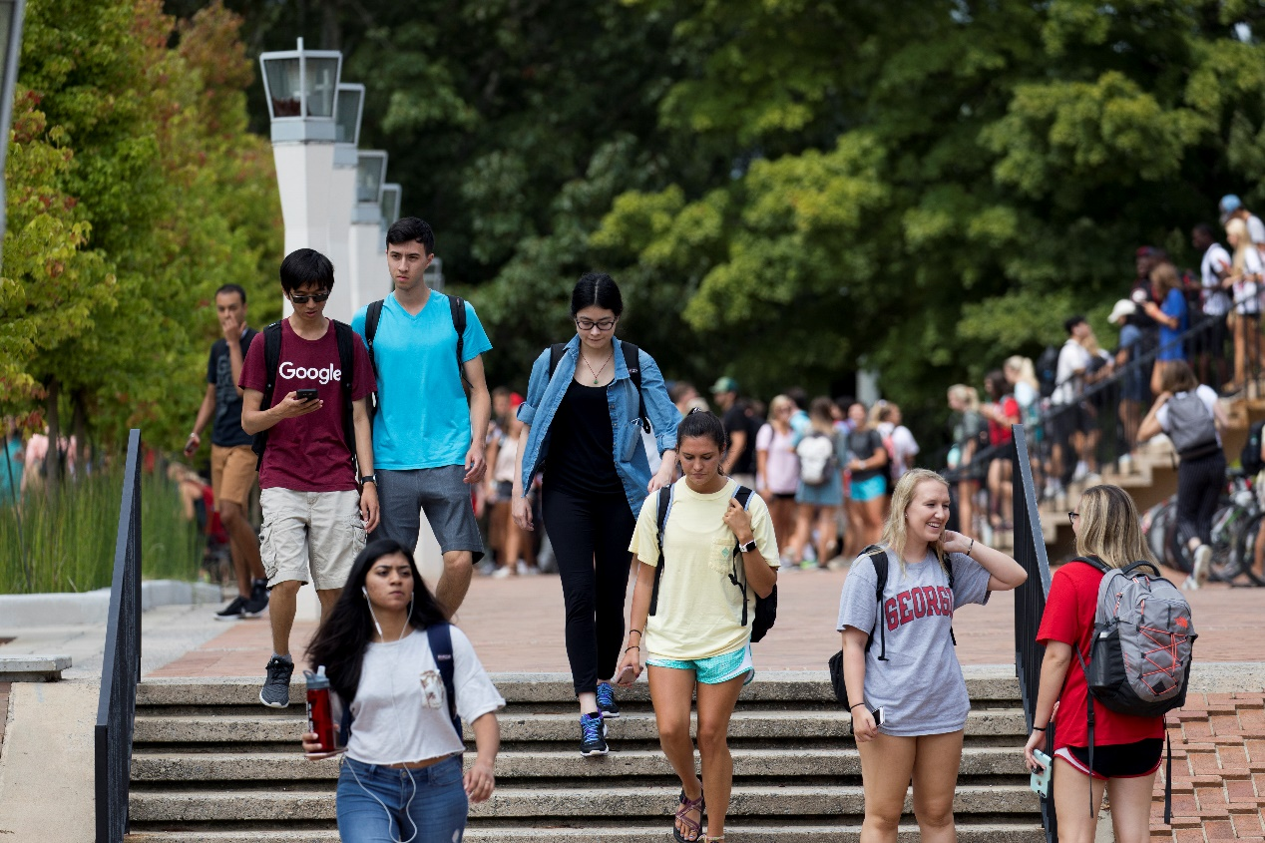
Explore Your Options!
Franklin Major Overview Pages
Franklin College Departmental Websites
Career Center Resources
…but most importantly…

Slide 11
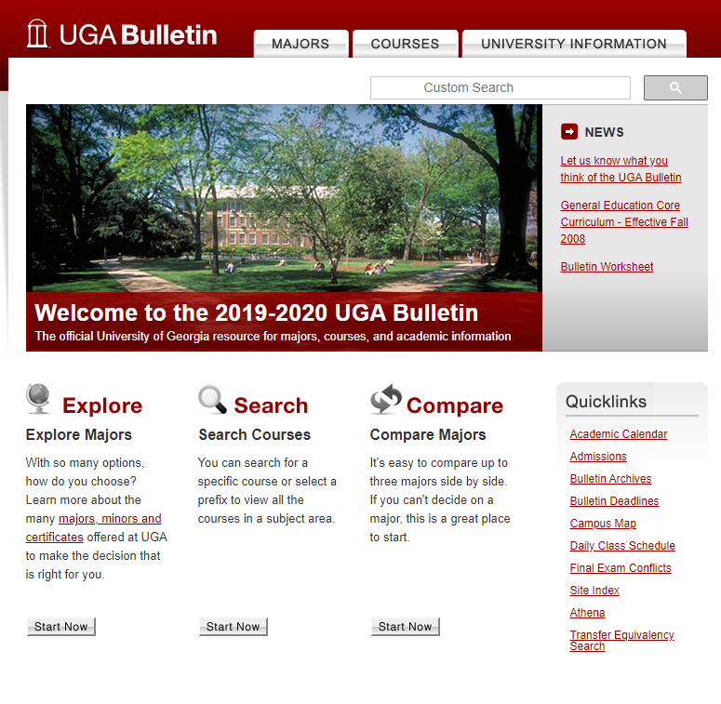
THE BULLETIN!
The University of Georgia’s undergraduate catalogue is know as the UGA Bulletin and is your centralized resource for all of the university’s degree and graduation requirements. In it you will find:
Undergraduate Majors
Course Descriptions
Degree Requirements
Minors and Certificates
Academic Policies

Slide 12
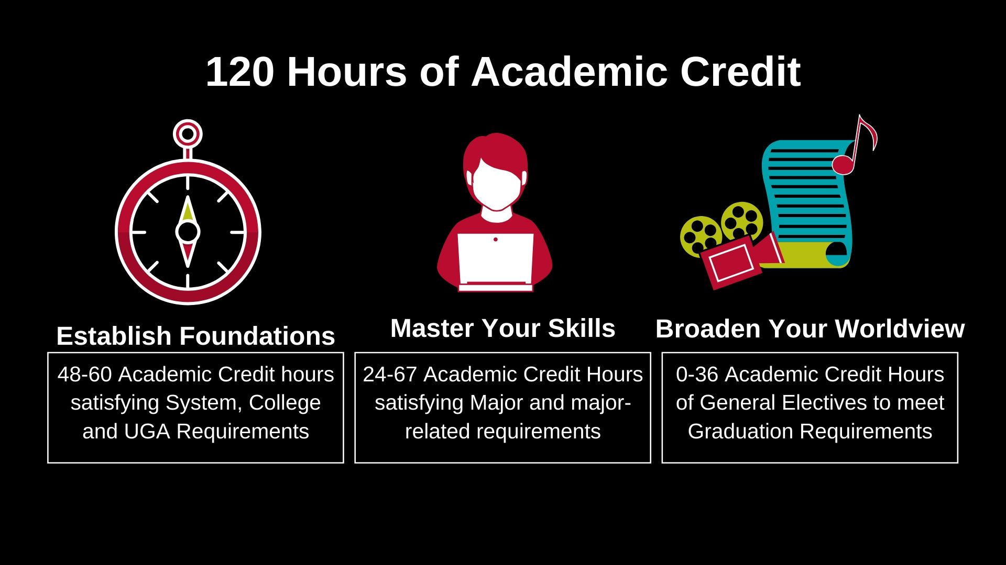
First and Second Years
Third and Fourth Years

Slide 13
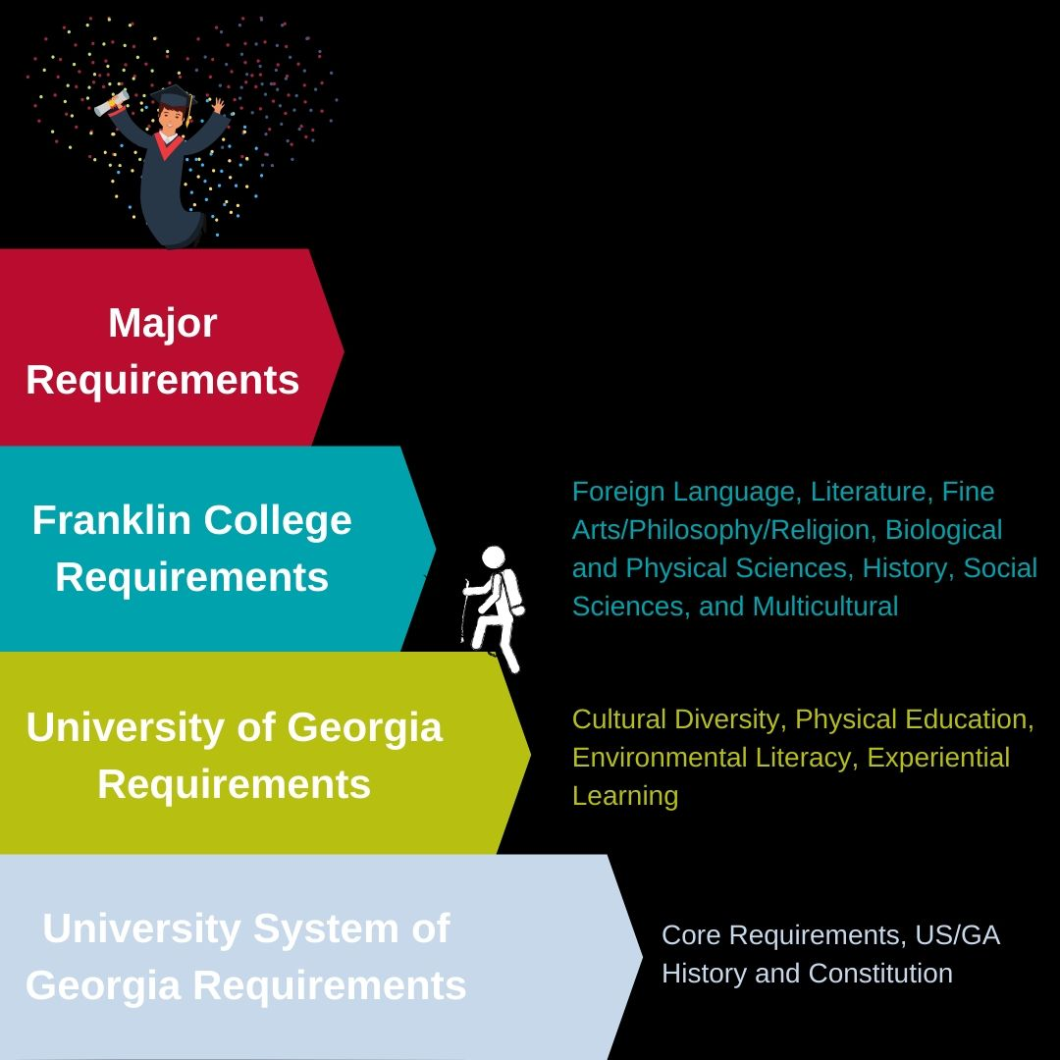
General Degree Requirements

Slide 14
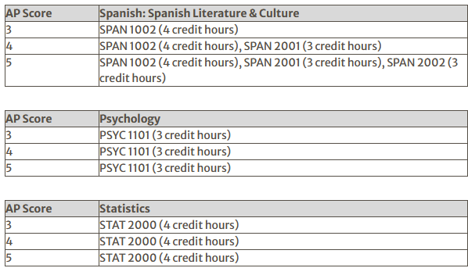
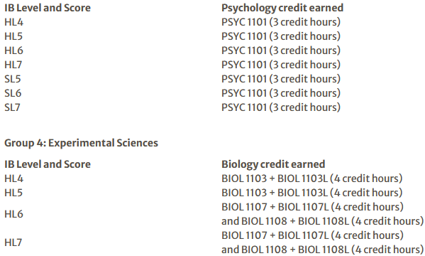
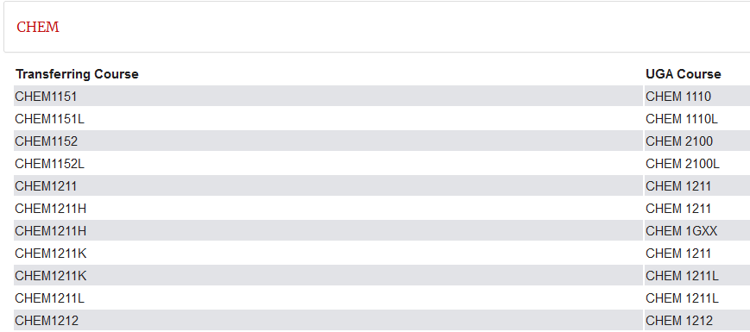
Have You Already Earned College Credit?
Many “core” (foundational) classes can be exempted through AP, IB, and dual-enrollment (transfer) credit. The result of this is that you have the opportunity to add to your academic program (minors, certificates, etc…) or possibly graduate early!
AP Equivalences
IB Equivalences
Transfer Equivalences

Slide 15
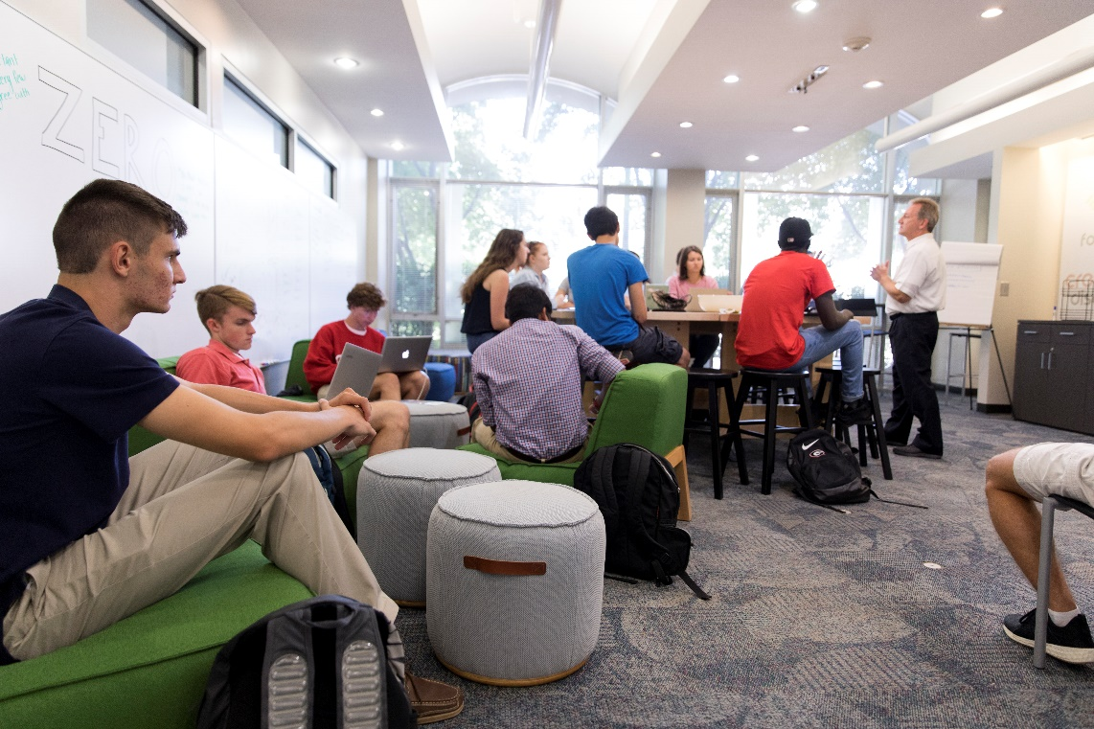
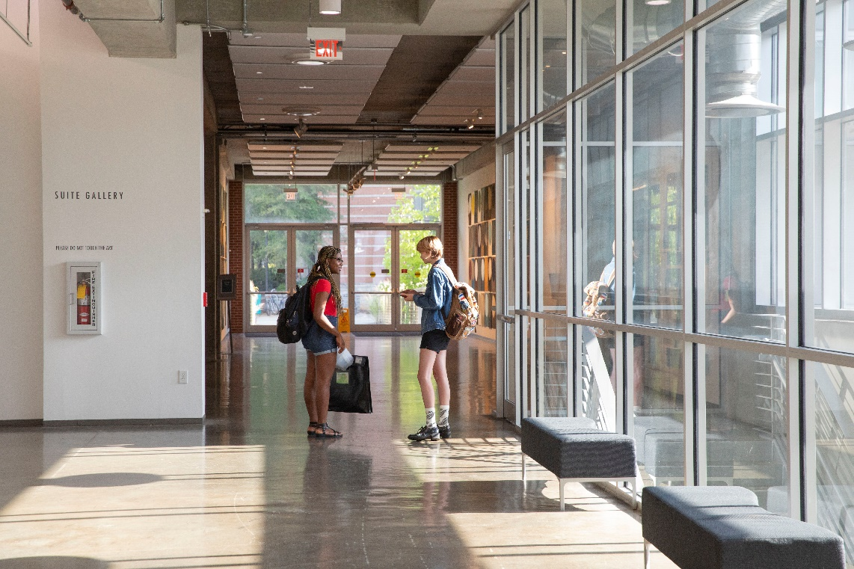
Preparing for Change
UGA’s Curriculum is rigorous, but there’s help!
Division of Academic Enhancement:
Individual and group tutoring in most subjects
Academic Coaching to help with time management and study skills
UNIV classes to help adjust to UGA
Online tutorials for quick help
Writing Centers at multiple locations on campus
Mathematics Study Hall offered for all MATH courses
Conversation Tables for many languages
Pre-Professional Office: To assist with getting into professional schools after graduation (law, health, etc…)

Slide 16
Rutherford Hall
Dr. Montgomery wolf, Director
DR. Danielle bostick, academic advisor in residence

Slide 17
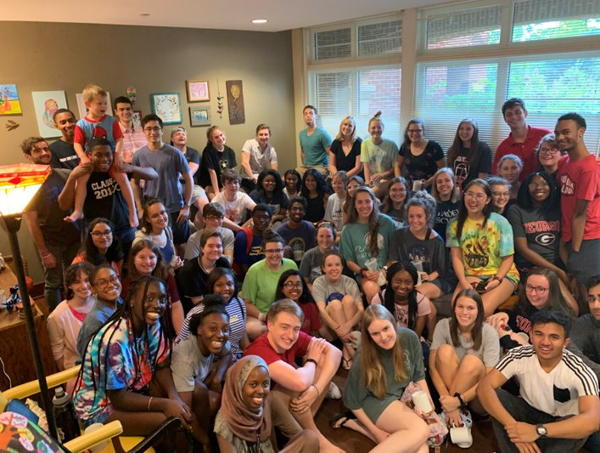
Student led - Faculty & staff mentored
95 students, all years and majors
Leadership opportunities
Volunteered & paid positions - experiential learning
Academic, Service and Social programs
Points and reward system for participating

Slide 18
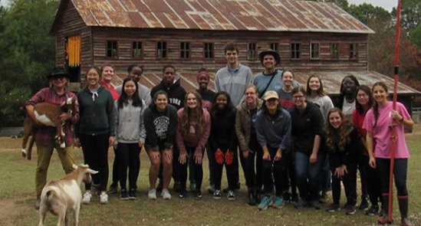
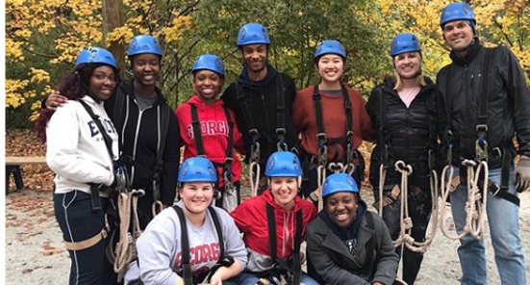
FYOS 1001 at Rutherford with first year students in the program
Cookie nights
Talk and tea with faculty speakers
Community service
Professional development opportunities
Annual trip to Sapelo Island
Day trips off camps
Community garden
Board game and movie nights
Wellness activities
And more!
Apply on frc.uga.edu​
Questions? Email us at frc@uga.edu​
Follow us on Instagram (@frc_uga) to stay updated!

Slide 19
Career Resources
For UGA students!

Slide 20
UGA Career Center!

Slide 21
Students can choose mentors based on all kinds of criteria
Major, identification, location, career, age, etc.
Every singe student I know who has taken part in the program has been thankful for the experience
And some students have gotten internship leads or internships from their mentors

Slide 22
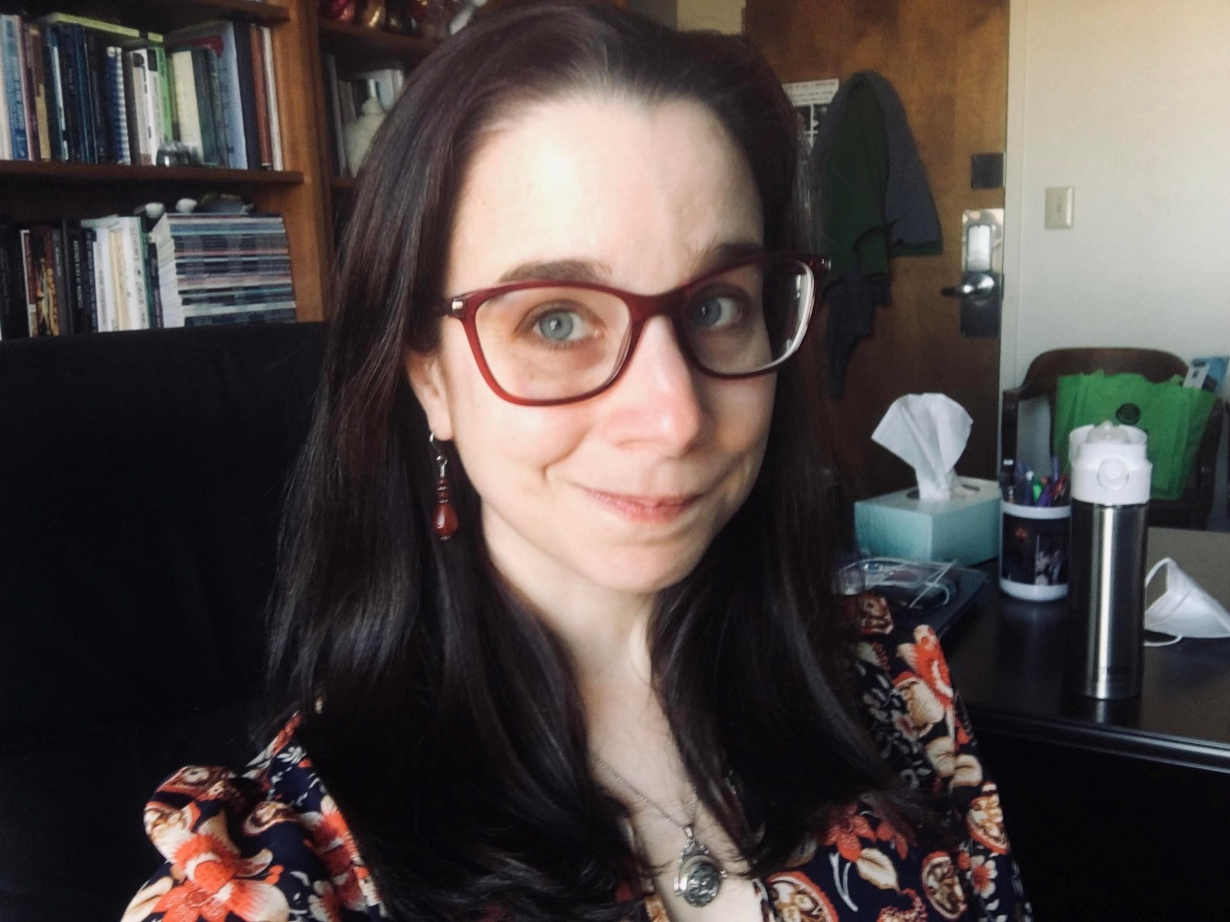
And lastly
Christine Lasek-White, Professor in the English Department and Internship and Career Coordinator for the Humanities
Prior to getting my MFA in Creative Writing, I worked for 8 years in Detroit as a web journalist and public relations professional
With only a bachelors in English
So I know what it’s like to go on the job market armed only with a humanities degree
And if I could do you, you can, too
I promise!
Email me for an appointment: cmlwhite@uga.edu

Slide 23
Questions?

